Slide 1
ASP.NET MVC 5
4 WEEKS COURSE

Slide 2
Contents
Installation Fest
Getting Started with C#
Hello World
Refreshing the basics
Object Oriented Programming
Live Coding Demos and Practice

Slide 3
Installation Fest

Slide 4
Installation of Required Tools
.NET Framework 4.5
MS Visual Studio .NET
MS SQL Server (2016) for Databases (Can install in later stage)

Slide 5
Getting Started with C#

Slide 6
Hello World From C#
First Program using C#
Start with basics
Console Application
Understand flow of the program

Slide 7

Refreshing the Basics
First Program using C#
Start with basics
Console Application
Understand flow of the program

Slide 8
Introduction to C#
Overview:
C# is a modern, object-oriented programming language
developed by Microsoft.
It is part of the .NET ecosystem.
Key Features:
Strongly typed
Automatic memory management (Garbage Collection)
Support for asynchronous programming

Slide 9
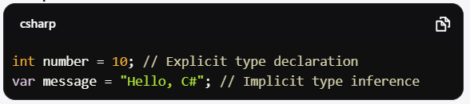
Variables
Definition: Variables are symbols that store data values.
Declaration and Initialization:
Can be declared with a type or inferred with var
Example Code:

Slide 10
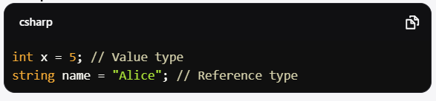
Data Types
Value Types:
Stored directly in memory.
Examples: int, float, double, char, bool
Reference Types:
Store references to the data (objects).
Examples: string, arrays, classes.
Example Code:

Slide 11
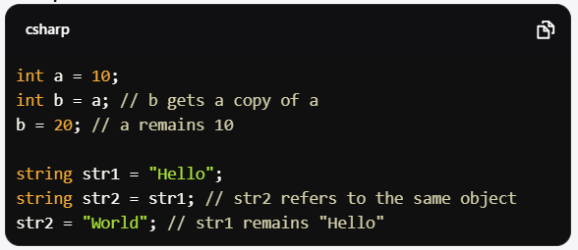
Value vs Reference Types
Value Types:
Stored in stack memory.
Each variable has its own copy of the data.
Reference Types:
Stored in heap memory.
Variables store references, pointing to the same memory location.
Example Code:

Slide 12
Value vs Reference Types
Value Types:
Store data directly in memory; examples include:
int: Represents integers (e.g., int age = 30;)
float: Represents floating-point numbers (e.g., float price = 19.99f;)
bool: Represents boolean values (e.g., bool isValid = true;)
Reference Types:
Store references to the actual data. Examples include:
string: Represents text (e.g., string name = "Alice";)
Arrays: Collections of elements (e.g., int[] numbers = {1, 2, 3};)
Custom classes: User-defined types
Example Code

Slide 13
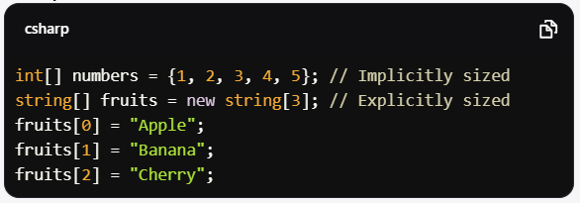
Arrays
Definition: A fixed-size collection of elements
of the same type.
Declaration and Initialization:
Can be initialized at declaration or later.
Example Code

Slide 14
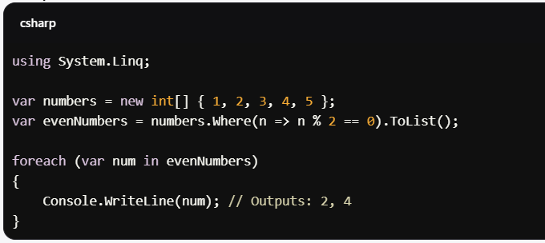
Introduction to LINQ
Definition: Language Integrated Query allows
querying of data in a more readable way.
Benefits:
Simplifies data manipulation.
Can work with arrays, collections, databases, XML, etc.
Common LINQ Methods
Where(): Filters a collection based on a predicate.
Select(): Projects each element into a new form.
ToList(): Converts the result to a list.
Example Code

Slide 15
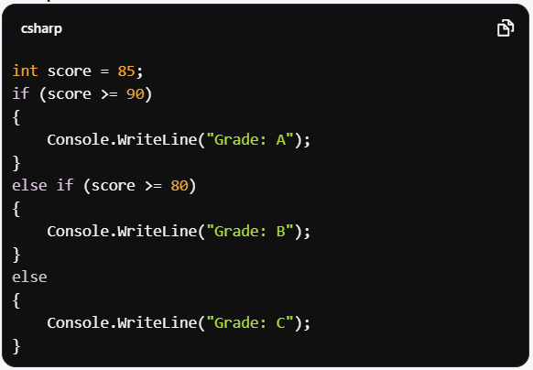
Control Structures - If-Else
Definition: Used to execute code based on conditions.
Syntax:
Supports multiple conditions with else if.
Example Code:

Slide 16
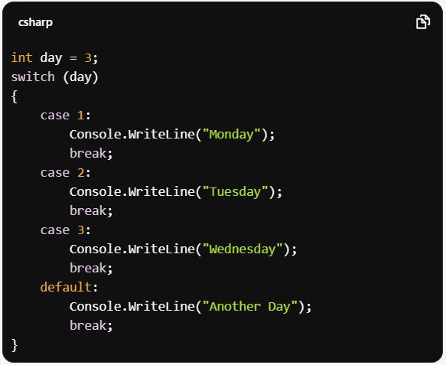
Control Structures - Switch
Definition: A control structure for multi-way branching.
When to Use: When you have multiple conditions based
on a single variable.
Example Code

Slide 17
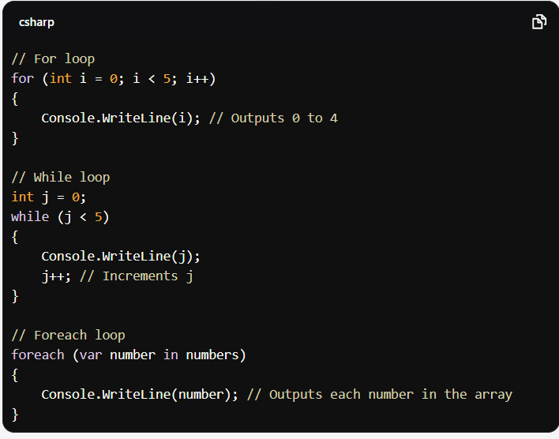
Loops
Types of Loops:
for: Used when the number of iterations is known.
while: Used when the number of iterations is not known.
foreach: Used for iterating over collections.
Example Code

Slide 18
Object Oriented Programming

Slide 19
Overview of Object-Oriented Programming
Definition:
A programming paradigm based on the concept of "objects," which can contain data and methods.
Key Principles:
Encapsulation: Bundling the data and methods that operate on the data.
Inheritance: Creating new classes based on existing classes.
Polymorphism: Allowing methods to do different things based on the object they are acting upon.
Benefits:
Improved code reusability
Easier maintenance
Enhanced scalability

Slide 20
Basic Walkthrough of OOP
Core Concepts:
Classes: Blueprints for creating objects.
Objects: Instances of classes.
Methods: Functions defined inside classes.
// Class definition
public class Car
{
public string Make { get; set; }
public string Model { get; set; }
public void Drive()
{
Console.WriteLine("The car is driving.");
}
}
// Creating an object
Car myCar = new Car();
myCar.Make = "Toyota";
myCar.Model = "Corolla";
myCar.Drive(); // Output: The car is driving.

Slide 21
Classes and Libraries
Classes:
Define the structure and behavior of objects.
Can contain fields (data members) and methods (functions).
Libraries:
Collections of classes and methods that can be reused in different programs.
Example: .NET Framework libraries provide a vast array of functionalities.
// Defining a library class
public class Calculator
{
public int Add(int a, int b) => a + b;
public int Subtract(int a, int b) => a - b;
}
// Using the Calculator class
Calculator calc = new Calculator();
int sum = calc.Add(5, 3); // sum = 8

Slide 22
Encapsulation
public class BankAccount
{
private decimal balance; // Private field
public void Deposit(decimal amount)
{
balance += amount;
}
public decimal GetBalance()
{
return balance;
// Public method to access private data
}
}
// Usage
BankAccount account = new BankAccount();
account.Deposit(100);
Console.WriteLine(account.GetBalance()); //Output: 100
Definition: The bundling of data (attributes) and methods (functions) that operate on that data into a single unit or class.
Purpose: To restrict direct access to certain components and maintain control over the data.

Slide 23
Inheritance
Definition: A mechanism where a new class derives from an existing class, inheriting its members (fields and methods).
Benefits: Promotes code reusability and establishes a hierarchical relationship between classes.
// Base class
public class Animal
{
public void Speak() => Console.WriteLine("Animal speaks");
}
// Derived class
public class Dog : Animal
{
public void Bark() => Console.WriteLine("Dog barks");
}
// Usage
Dog myDog = new Dog();
myDog.Speak(); // Output: Animal speaks
myDog.Bark(); // Output: Dog barks

Slide 24
Polymorphism
Definition: The ability of different classes to be treated as instances of the same class through inheritance. It allows methods to be overridden in derived classes.
Types:
Compile-time Polymorphism (Method Overloading)
Run-time Polymorphism (Method Overriding)
public class Bird
{
public virtual void Fly() => Console.WriteLine("Bird flies");
}
public class Sparrow : Bird
{
public override void Fly() => Console.WriteLine("Sparrow flies quickly");
}
// Usage
Bird myBird = new Sparrow();
myBird.Fly(); // Output: Sparrow flies quickly

Slide 25
Access Modifiers
Definition: Keywords that set the accessibility of classes, methods, and other members.
Types:
public: Accessible from anywhere.
private: Accessible only within the same class.
protected: Accessible within the same class and by derived classes.
internal: Accessible within the same assembly.
public class Person
{
private string name; // Private field
public int Age { get; set; } // Public property
protected void SetName(string newName) // Protected method
{
name = newName;
}
}

Slide 26
Conclusion
Summary:
Covered core C# concepts: variables, data types, control structures, and LINQ.
Emphasized the differences between value and reference types
Reviewed core OOP concepts: Classes, encapsulation, inheritance, polymorphism, and access modifiers.
Highlighted how these principles enhance code organization, reusability, and maintainability.
Next Steps:
Explore more advanced OOP concepts: Interfaces, abstract classes, design patterns.
Recommended resources: Microsoft documentation, OOP tutorials, and coding practice platforms.

Slide 27
شــــــكــــرًا لكــــــم
THANK YOU

